Slide 1
Signal Processing Primer
Establishing and assessing ground knowledge of the mathematical formulas underpinning signal processing in neuroscience.
Foundations of Geometry for Signal Processing – 20 minutes
Key Formulas - 25 minutes
MATLAB Implementations – 15 minutes
TRFs With Enrico – 30 minutes

Slide 2
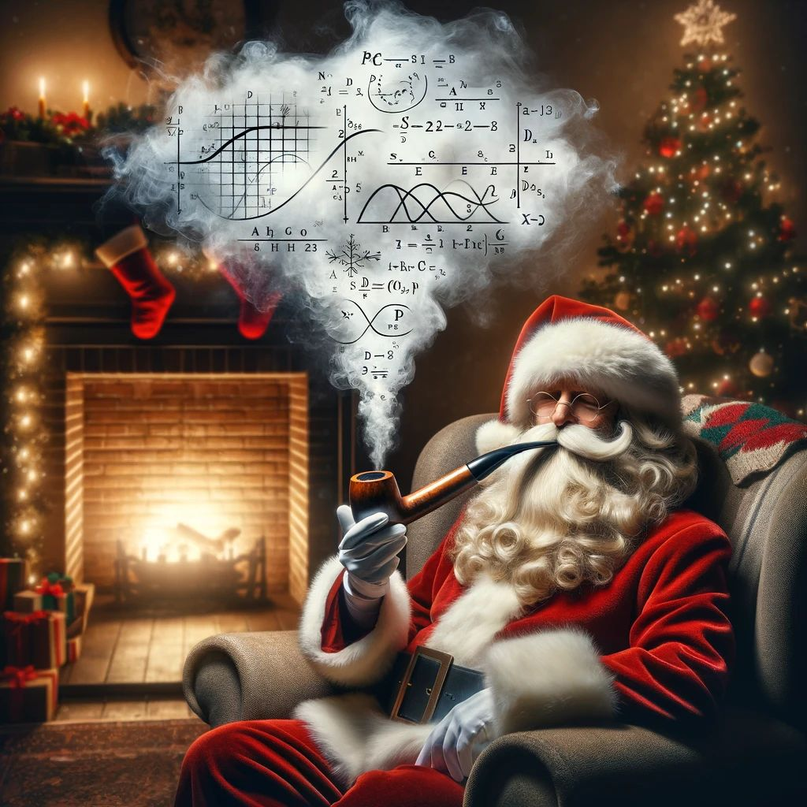
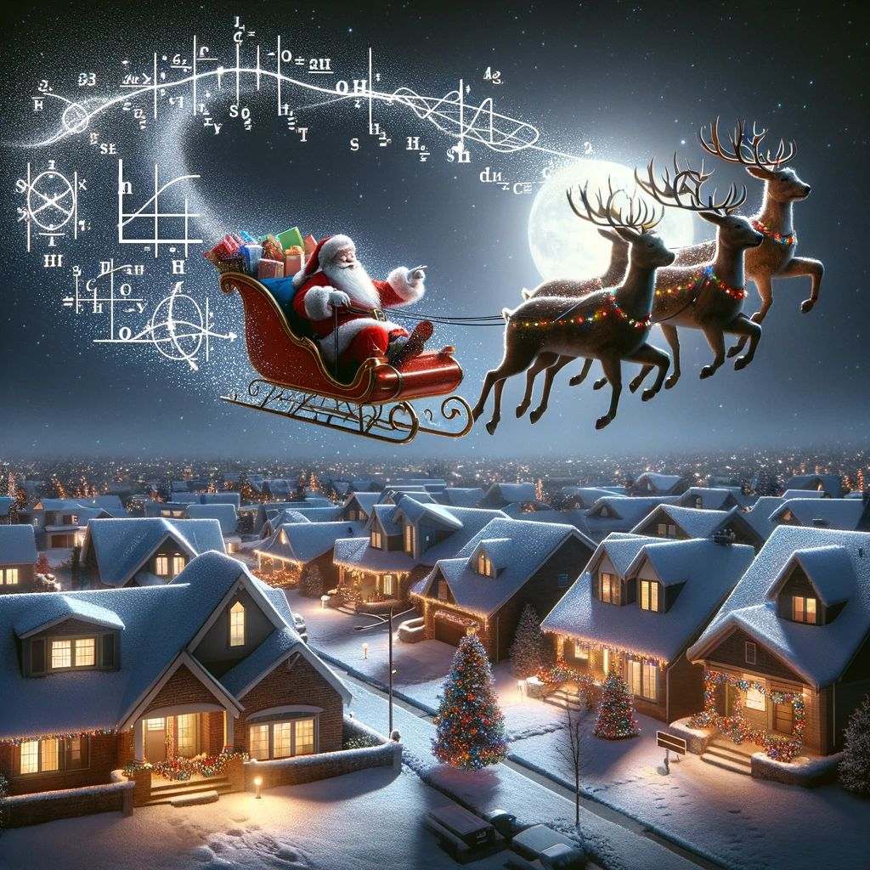
Festive Signal Processing Primer
A festive introduction to the what, why, and how of signals so that your holidays are complete.
New and Improved!
100% More Festive!
99% Less Math!
Thank you Signal Santa!

Slide 3
Festive Structure
The take home message.
What is a signal?
What is signal processing?
Why is signal processing?
How is signal processing?

Slide 4
Festive Takeaway!
IF YOU TAKE NOTHING ELSE FROM THIS SESSION, TRY TO TAKE AWAY THE FOLLOWING POINTS
The foundation of Signal Processing is thinking about data from the point of view of models and parameterization.
Everything is a signal
Everything in science is the first point.

Slide 5
Festively, What is a Signal?

Slide 6
Festively, What is a Signal?
A signal is data over time and/or space!

Slide 7
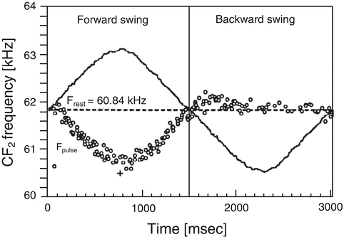
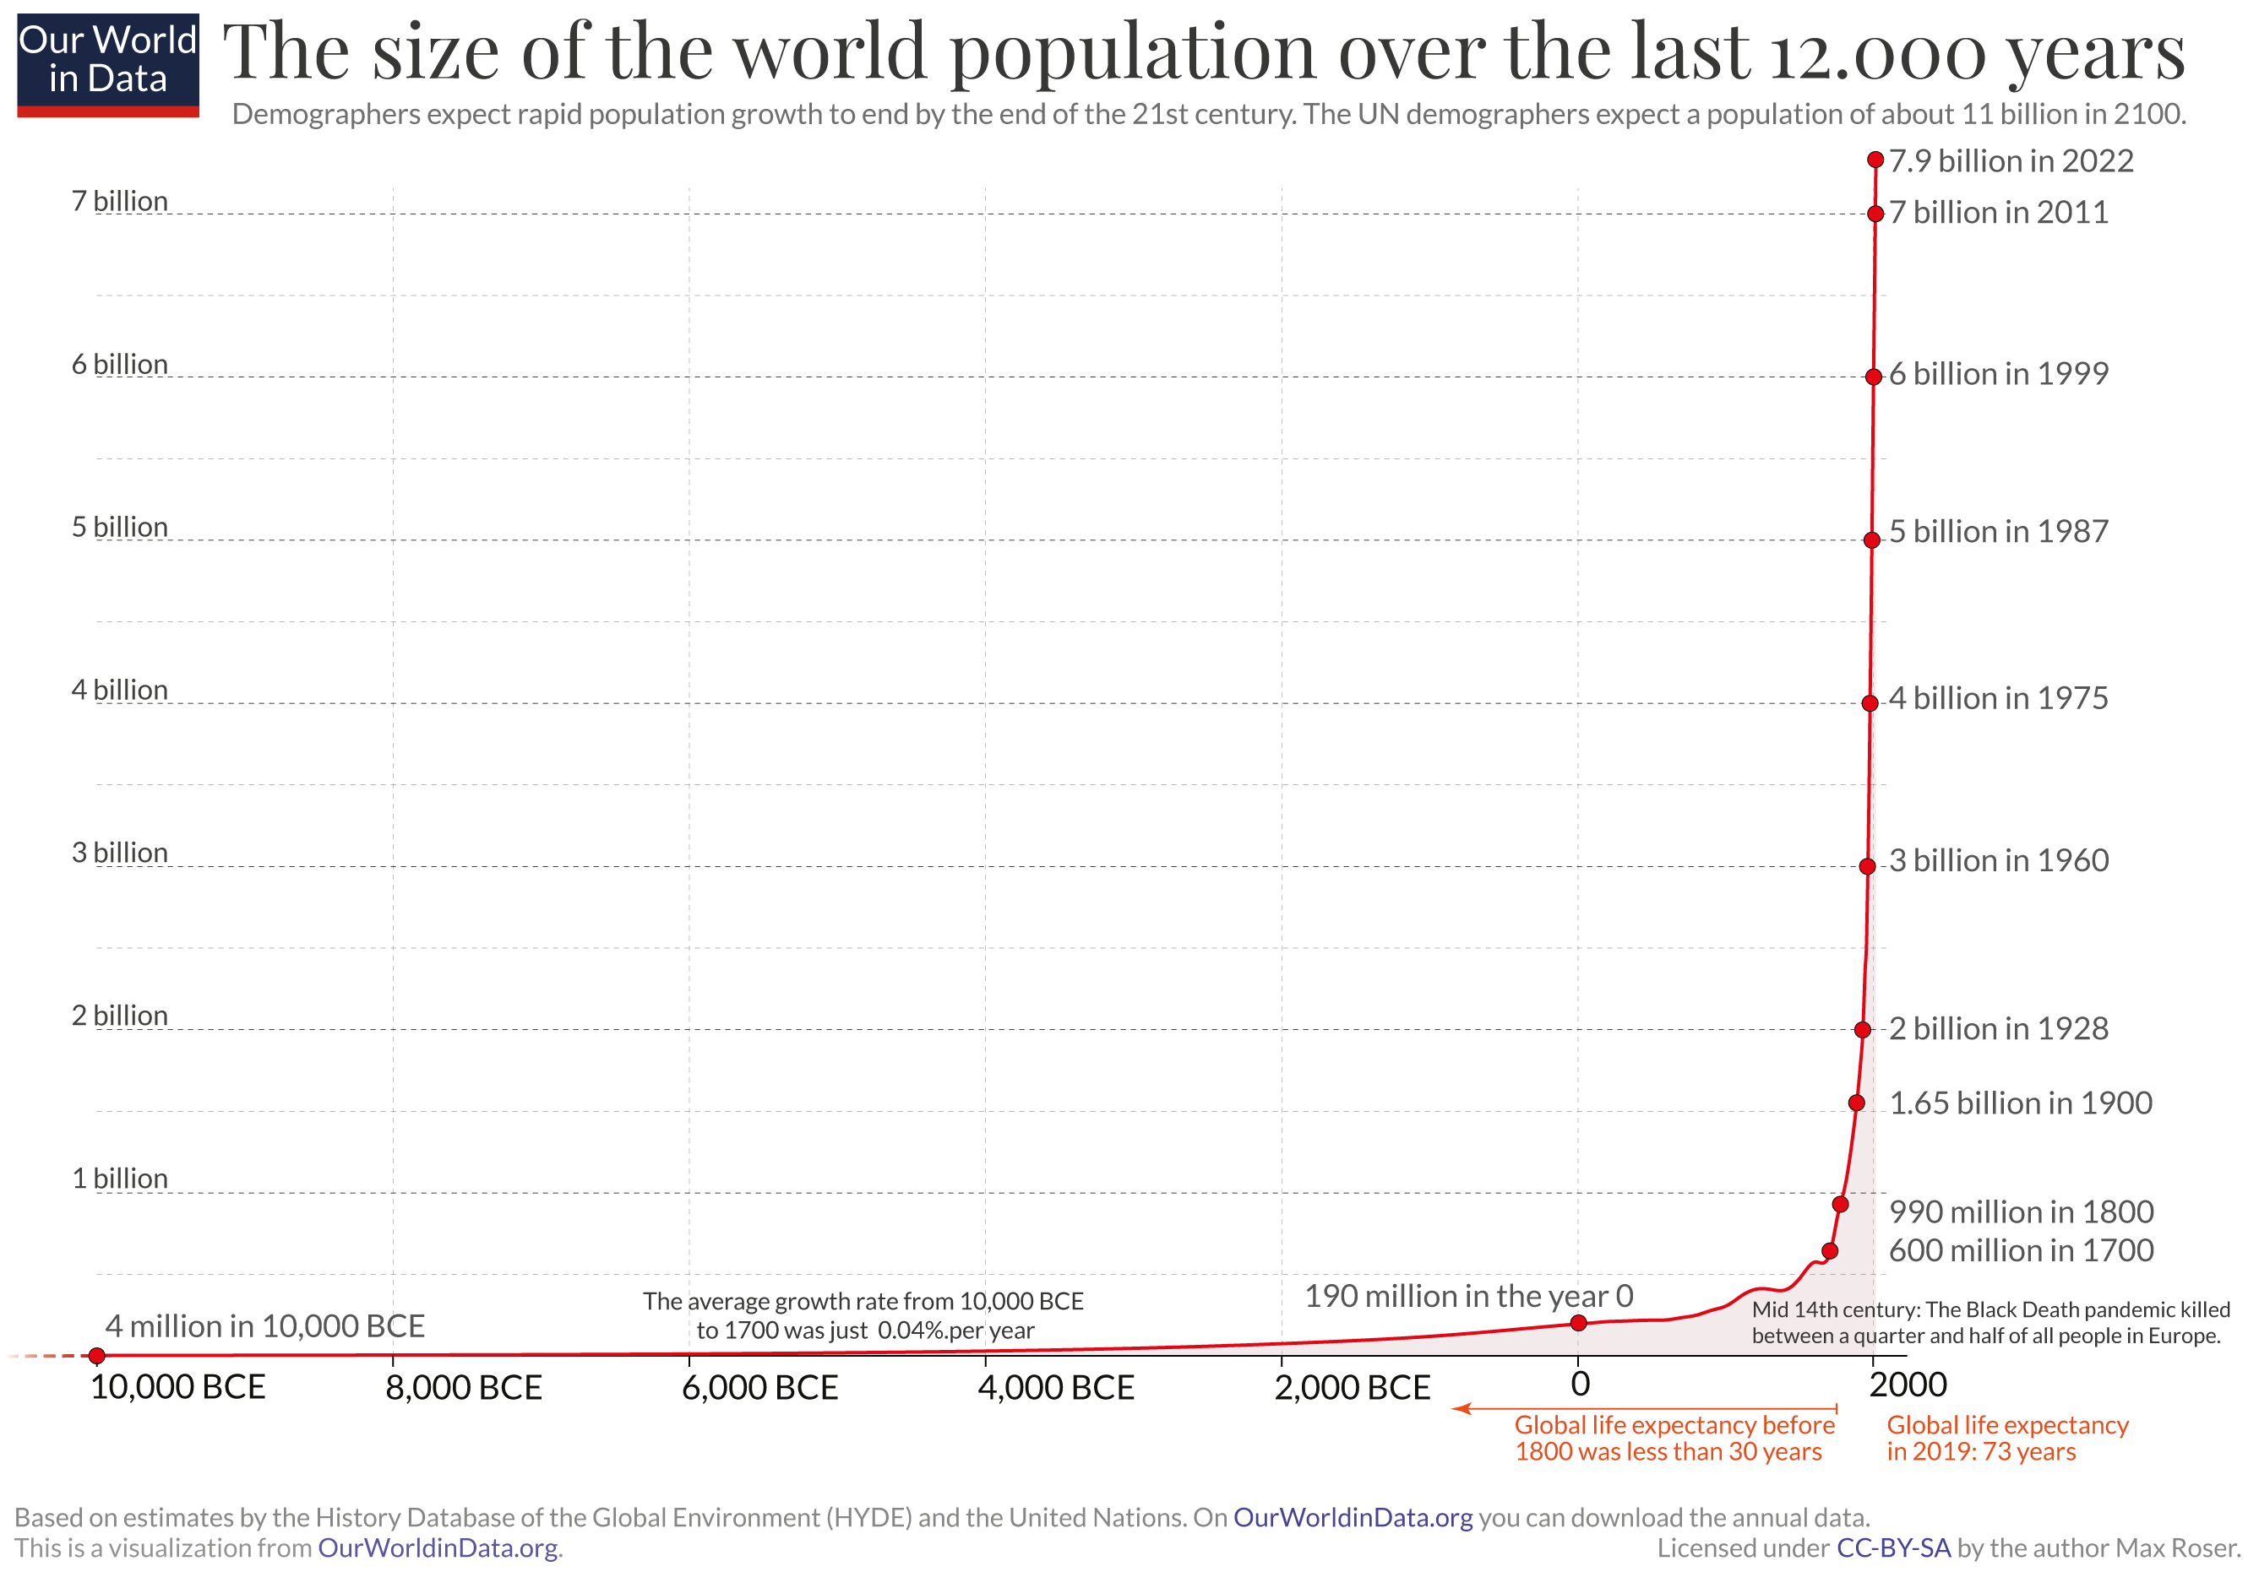
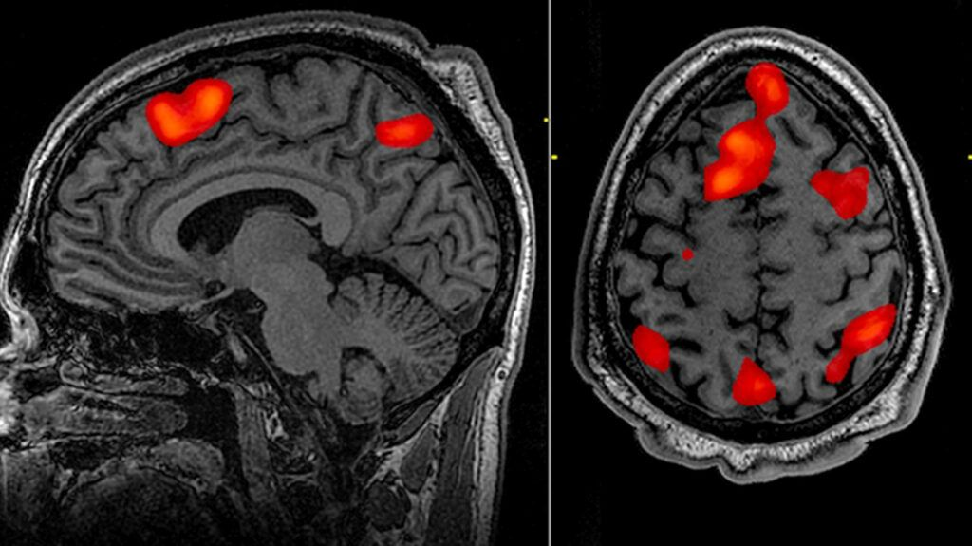
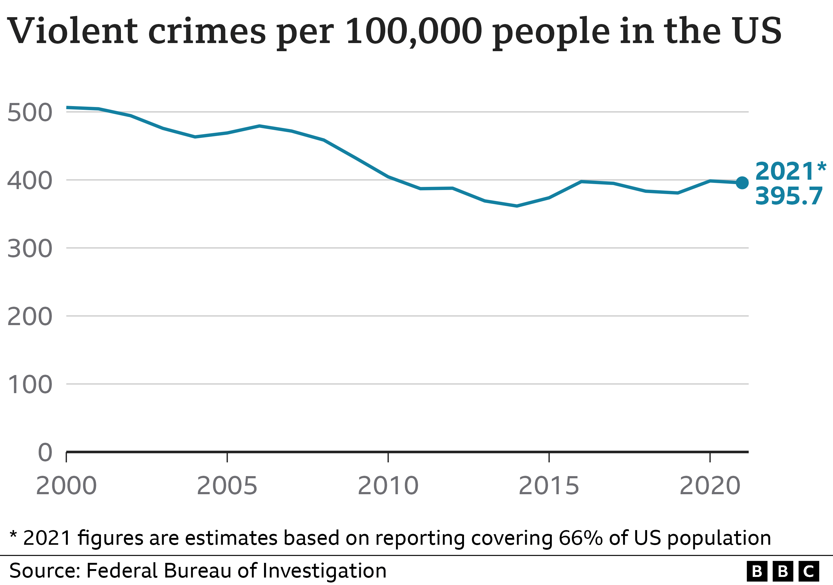
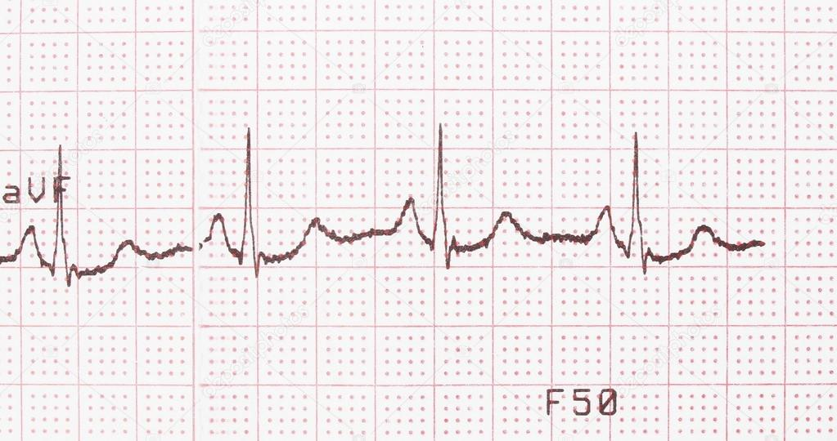
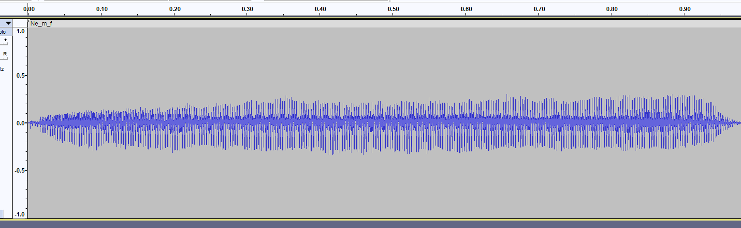
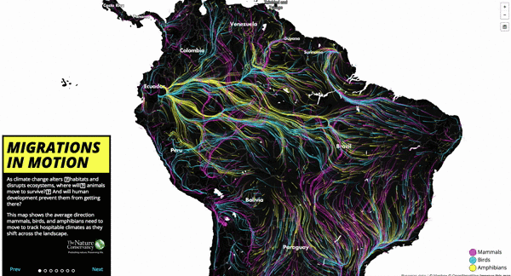
Festively, What is a Signal?
A signal is data over time and/or space!

Slide 8
Festively, What is a Signal?
Yes! Even data over a space is a signal.
The principles of signal processing apply over time, space, or both at once.

Slide 9
Festively, What is a Signal?
Yes! Even data over a space is a signal.
The principles of signal processing apply over time, space, or both at once.
Even as auditory researchers, we deal with time, space, or both. What are the following?
EEG/MEG
FMRI
Images
Audio

Slide 10
Festively, What is Signal Processing?
Manipulating a signal to change its characteristics or extract information!

Slide 11
Why Is Signal Processing? The festive philosophy of signal processing.
- We use signal processing to parameterise a phenomena.
- Driven via the use of models to help us extract these parameters.
- If we abstract this to its most fundamental purpose, it’s the act of separating ‘signal’ from ‘noise’.

Slide 12
Why Is Signal Processing? The festive philosophy of signal processing.
- We use signal processing to parameterise a phenomena.
- Driven via the use of models to help us extract these parameters.
- If we abstract this to its most fundamental level, it’s the act of separating ‘signal’ from ‘noise’.
This is everything we do!! Even with non-time series data, this is what we do every day!!!!!!!!!!!

Slide 13
Why Is Signal Processing? The festive philosophy of signal processing.
Everything?!

Slide 14
Why Is Signal Processing? The festive philosophy of signal processing.
Everything?! YES, EVERYTHING!!

Slide 15
Why Is Signal Processing? The festive philosophy of signal processing.
Everything?! YES, EVERYTHING!! No, surely not!?

Slide 16
Why Is Signal Processing? The festive philosophy of signal processing.
Everything?! YES, EVERYTHING!! No, surely not!? Yes! Surely yes!

Slide 17
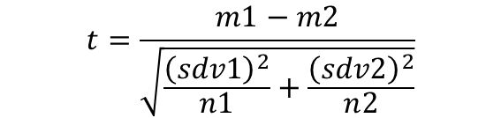
Why Is Signal Processing? The festive philosophy of signal processing.
- Everything we do is using a model to derive parameters from data and working with those parameters.
- This is critical to scientific thinking!!!
- fMRI, EEG, spectrograms, general linear model…. Even the student’s T-Test!
- This can describe an infinite amount of data!! - https://www.desmos.com/calculator/han9zbgk1k
$$t=\frac{m1−m2}{\sqrt{\frac{{\left(sdv1\right)}^{2}}{n1}+\frac{{\left(sdv2\right)}^{2}}{n2}}}$$

Slide 18
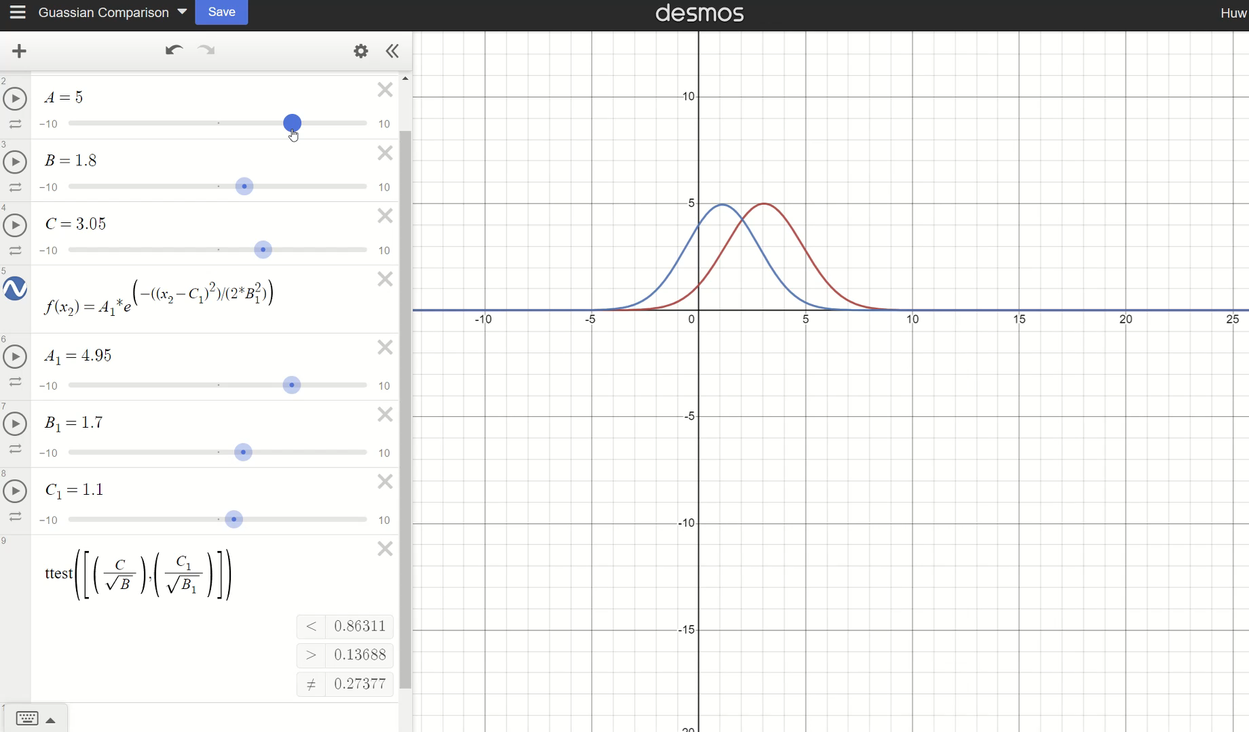
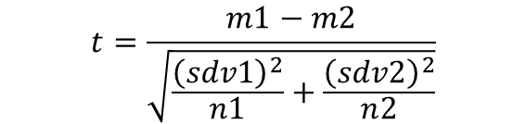
Why Is Signal Processing? The festive philosophy of signal processing.
$$t=\frac{m1−m2}{\sqrt{\frac{{\left(sdv1\right)}^{2}}{n1}+\frac{{\left(sdv2\right)}^{2}}{n2}}}$$
The variables of a Gaussian can describe a data set of infinite size!! - https://www.desmos.com/calculator/han9zbgk1k

Slide 19
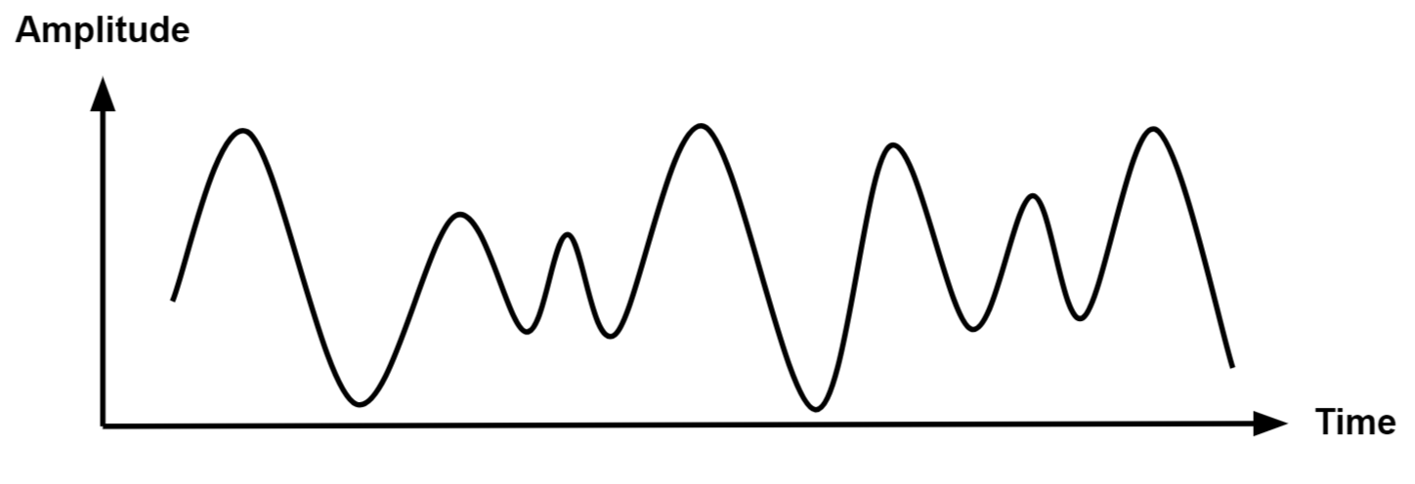
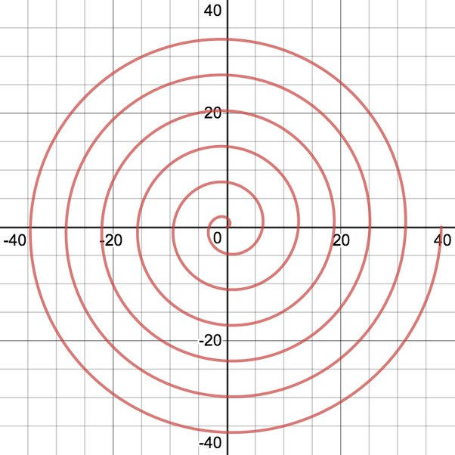
Why Is Signal Processing? The festive philosophy of signal processing.
So, if everything is like this, why is signal processing special from just ‘statistics’?
- Time series data is always constrained by direction – Samples can’t go ‘backwards’ in the mathematical space.
- All signals we collect have already undergone some degree of parameterization via restrictions in sampling. Discretization of continuous phenomena is mandatory!!
Sample rates, bit depth, sampling time, etc.

Slide 20
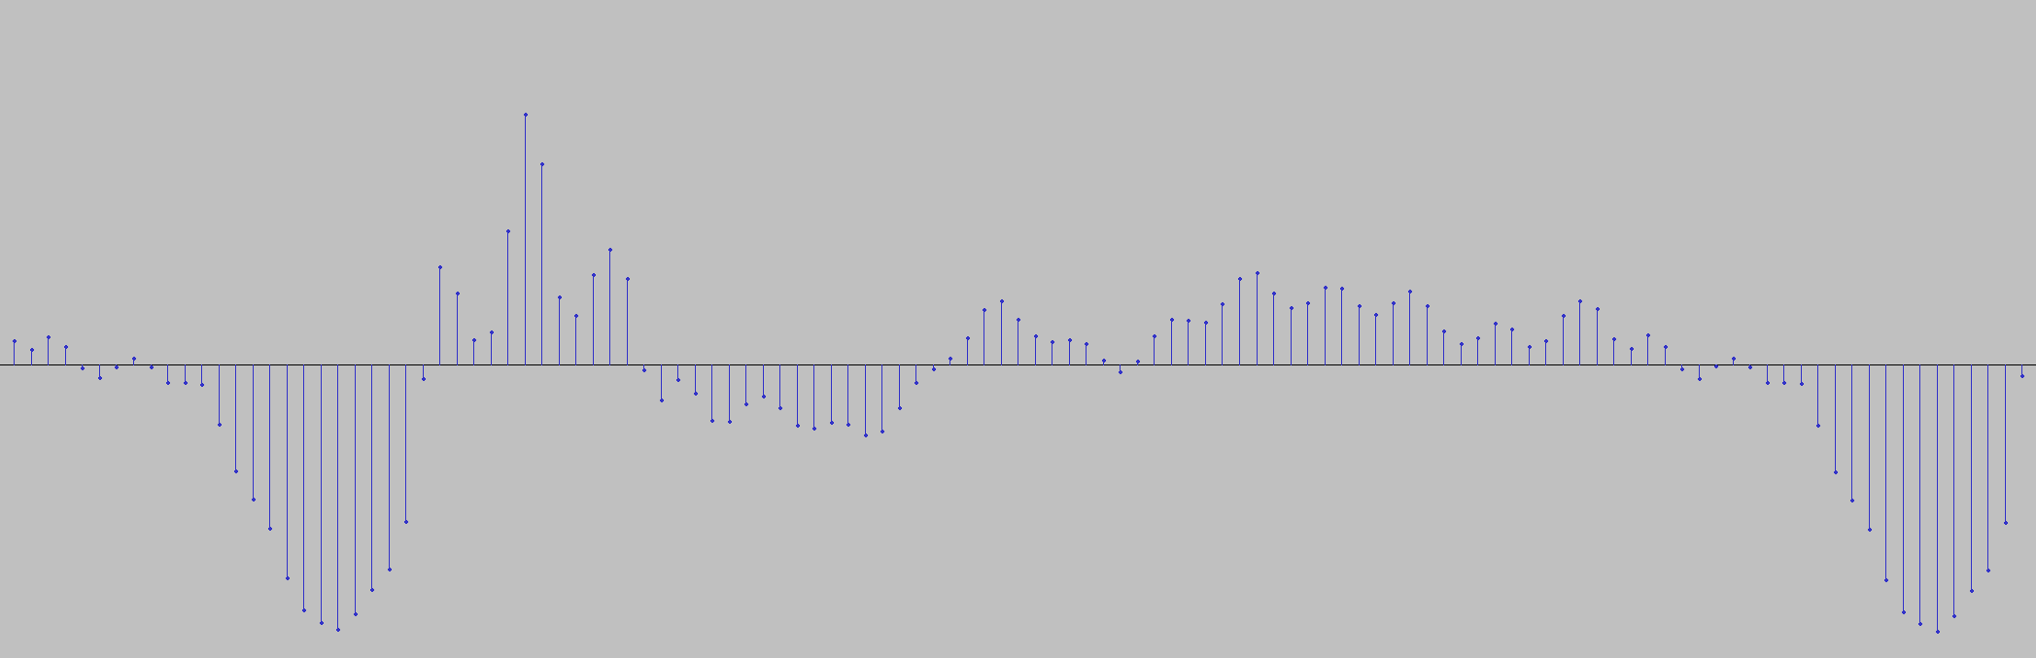
Why Is Signal Processing? The festive philosophy of signal processing.
Discretization of continuous phenomena in action!!

Slide 21
The Last Festive Point on Sig-Proc Philosophy
- We use models to derive parameters.
- These models are derived from a priori knowledge.
- And we must always remember general modeling concepts…
- Poor model = poor parameterization = poor analysis and understanding
- Model complexity = Model detail
- Model detail = Resilience to noise*
- Resilience to noise = Accuracy
- Model complexity = Model computational speed
* This kind of depends on the subtlety of the characteristic you’re trying to work with.

Slide 22
What are the most Festive Signal Processing concepts for us?
You will not learn how to do anything in one session… But we can go over core concepts to be aware of, and core uses to our research. There will be scant inclusion of mathematics.
Core applications:
EEG; auditory feature extraction/manipulation; all MRI processes; Neurostimulation; Eye-tracking; speech… Ok it’s really everything we do. Core Concepts:
- Waves (well, what is sound?)
- Sampling & Nyquist
- The Fourier Transform
- Filtering
- Convolution (leading to Enrico)

Slide 23
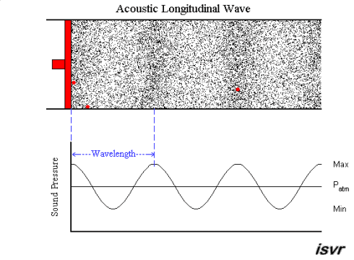
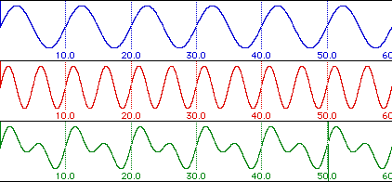
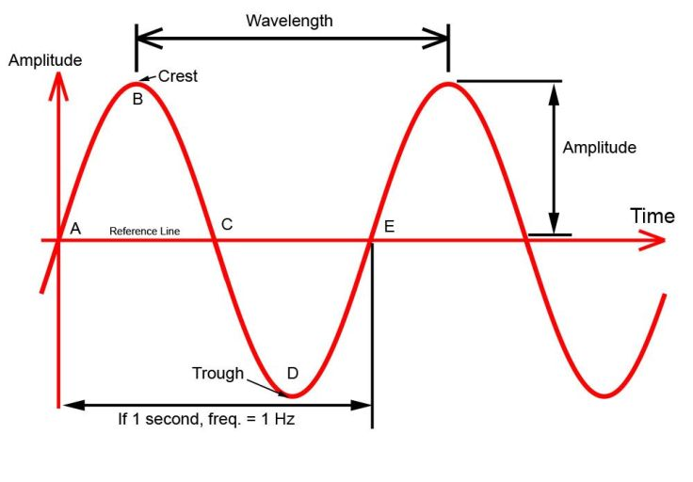
Winter Waves
Sound is the continuous oscillation of compression and rarefaction waves, transmitted through a medium (such as air).
Natural sound (complex) waves from a single source are made of a combination of sine waves (simple).
The characteristics of these sine waves can be measured/manipulated in our search for science.
Three parameters only:
- Frequency
- Amplitude
- Phase

Slide 24
Seasonal Sampling Rates & Nyquist Noel
In any measurement (EEG, MRI, audio recording, eye-tracking) there will two primary sampling parameters affecting your data.
- Sample rate: The frequency at which data points are acquired in time.
- Bit depth: The discrete levels each data point can have.

Slide 25
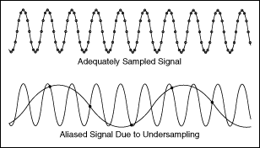
Seasonal Sampling Rates & Nyquist Noel
- All data sampling is going to ‘lossy’ to some degree.
- Our main concern will be sampling rate restrictions: Nyquist and Period Length
- Nyquist – Sampling frequency must be at least twice as signal frequency to prevent aliasing.
- e.g. To capture a 20hz signal, you must sample >40hz

Slide 26
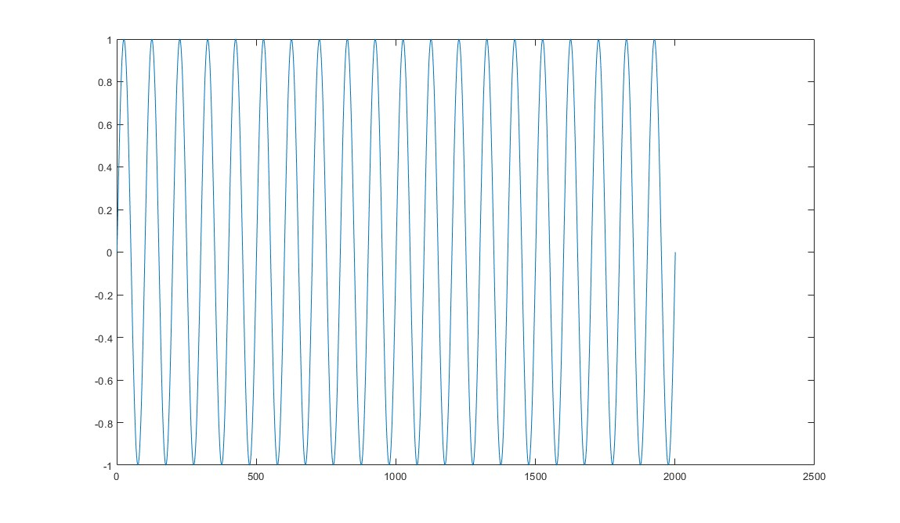
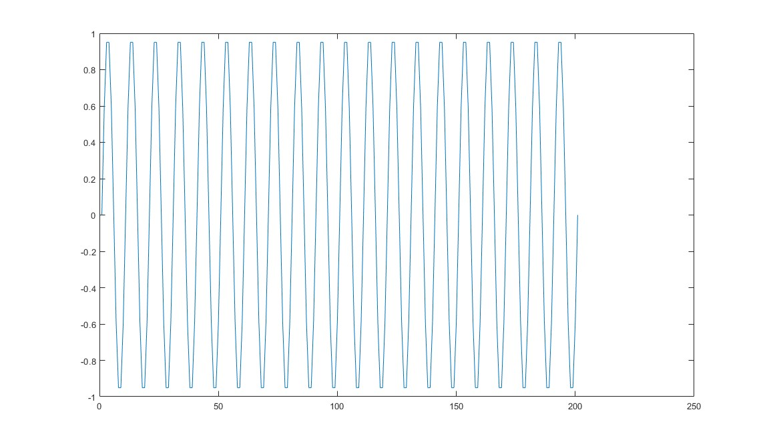
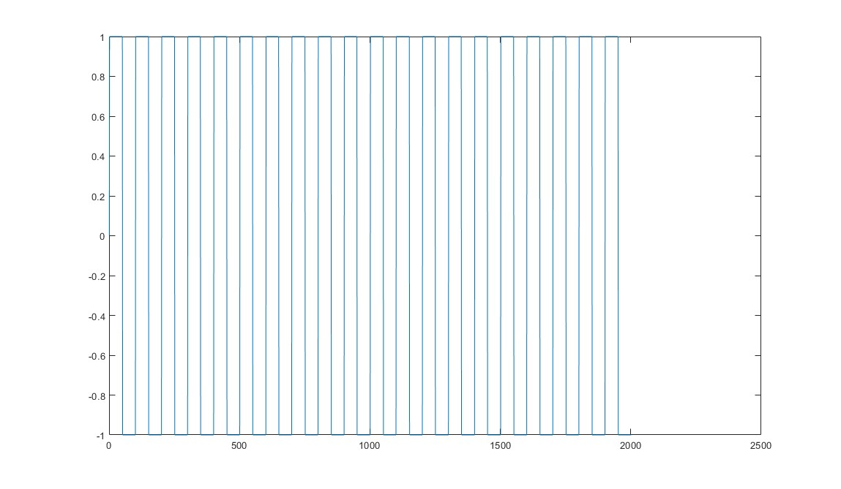
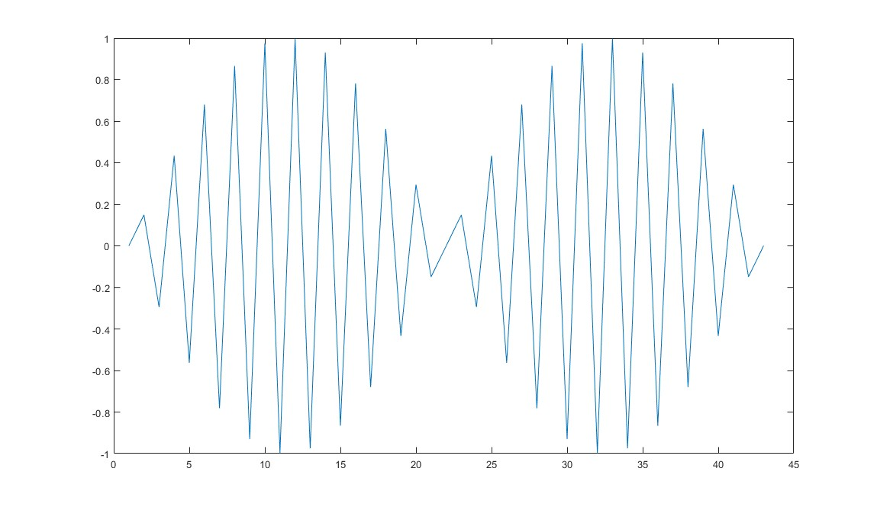
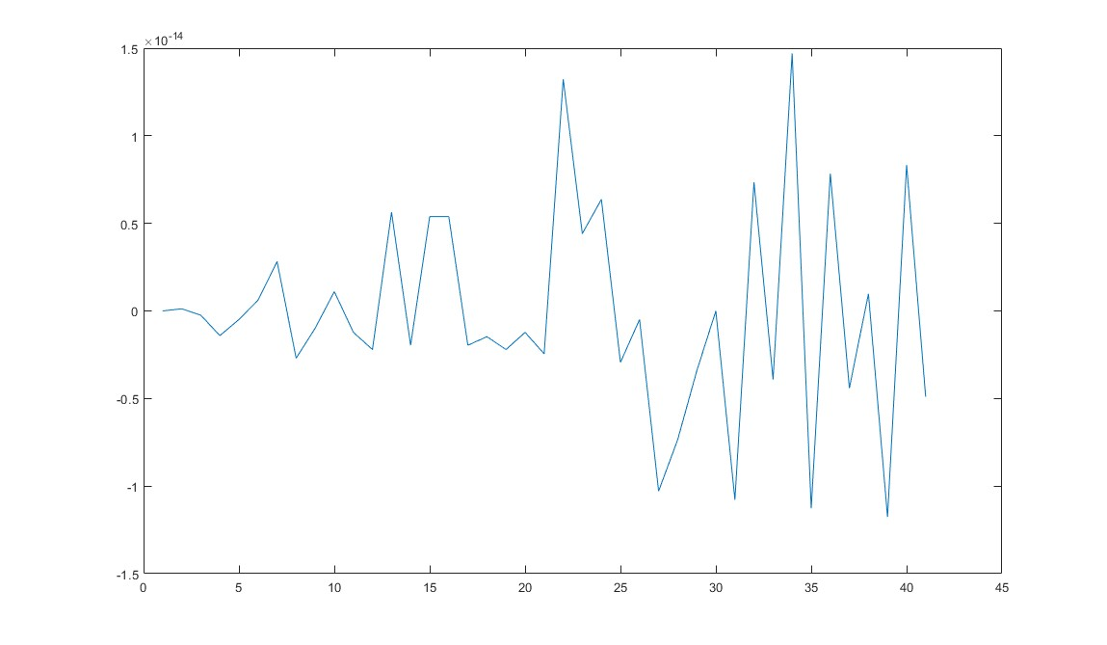
Seasonal Sampling Rates & Nyquist Noel
Being above Nyquist doesn’t guarantee exact representation of signal! Only frequency!
10hz @ 1000hz fs
10hz @ 100hz fs
10hz, 1000hz fs – But 2bit sampling instead of 64bit.
10hz @ 21hz fs
10hz @ 20hz fs – ALIASING!

Slide 27
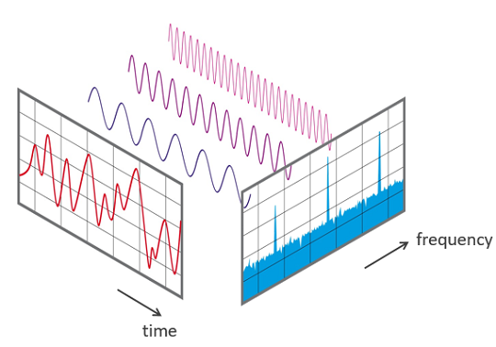
FFT – The Festive Fourier Transform
Run from it, dread it…. The Fourier Transform arrives all the same….
- I am neither skilled nor sadistic enough to teach Fourier in a single sitting… but hopefully I can take the sting out of it.
- A signal is a function of amplitude over time. Fourier Transform gives us a function of amplitude over frequency. - That is all it does!! Simples!!

Slide 28
FFT – The Festive Fourier Transform
Two Questions!
What is a function?
What is a transform?

Slide 29
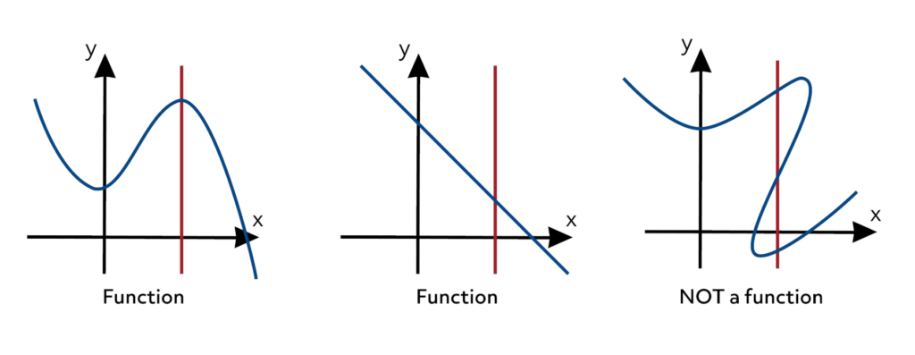
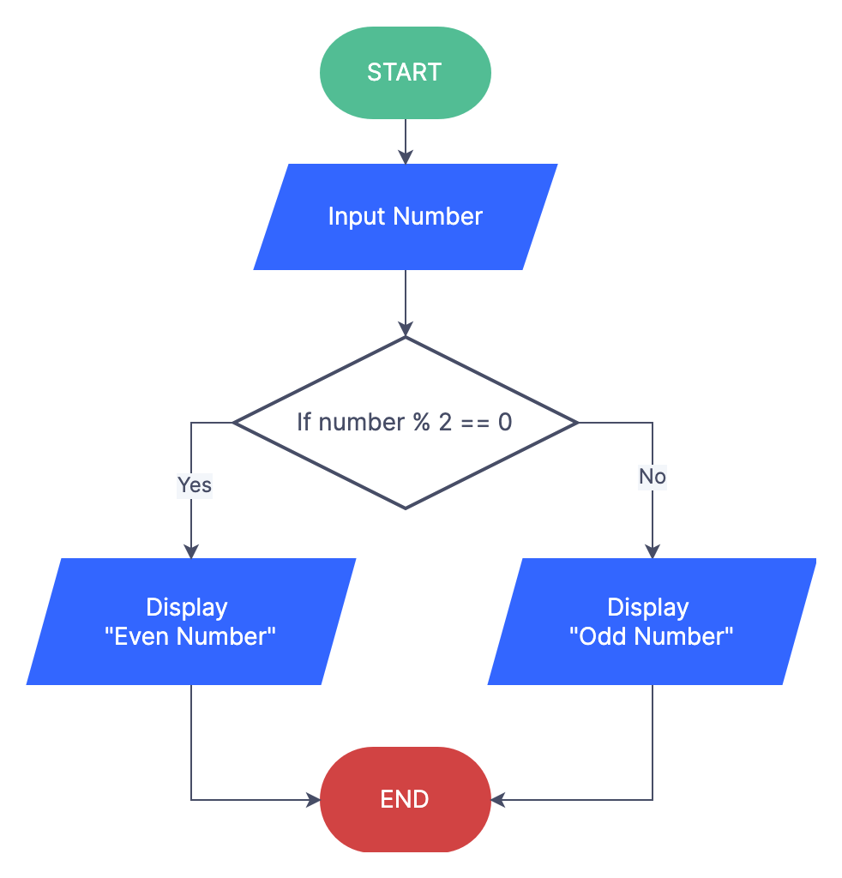
Festive Functions, Tidings Transfers, Advent Algorithms
No maths still!
Function
Algorithm
A relationship of how each input of point X has a corresponding output of point Y .e.g – A sine wave; a gaussian; a parabola; a line.
Exceedingly useful as functions have parameters!
Integral Transform
The mechanistic series of steps for performing a given task/process.
Maps a function from it’s original ‘function space’, into a new ‘function space’.

Slide 30
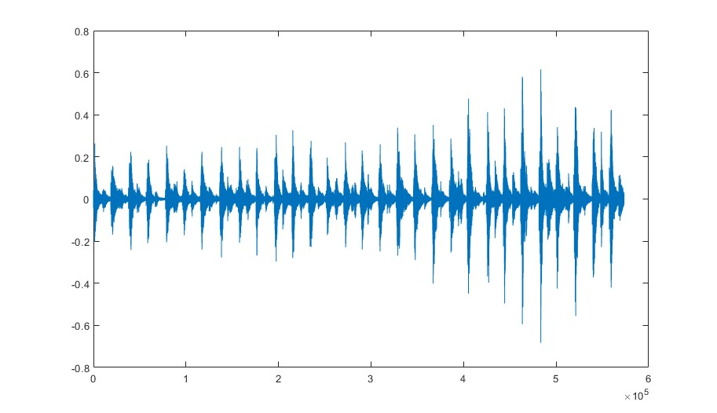
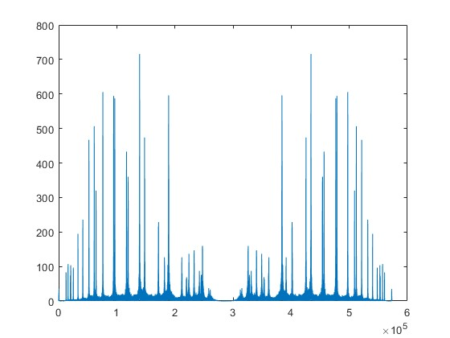
FFT – The Festive Fourier Transform
- If we’re trying to understand/manipulate any frequency component of a signal, the FT is central, including amplitude modulation/frequency band modulation etc.

Slide 31
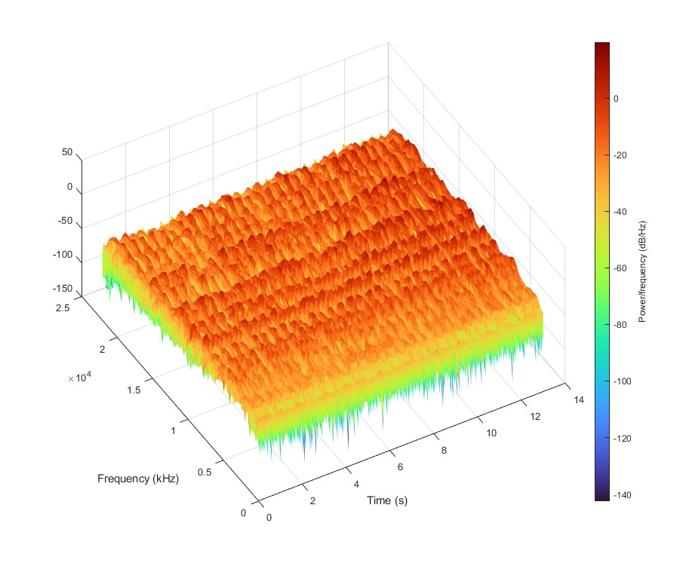
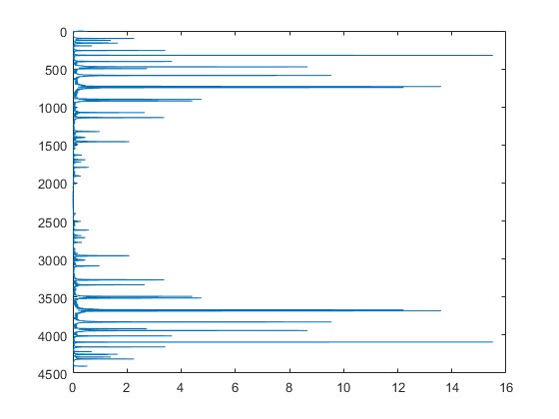
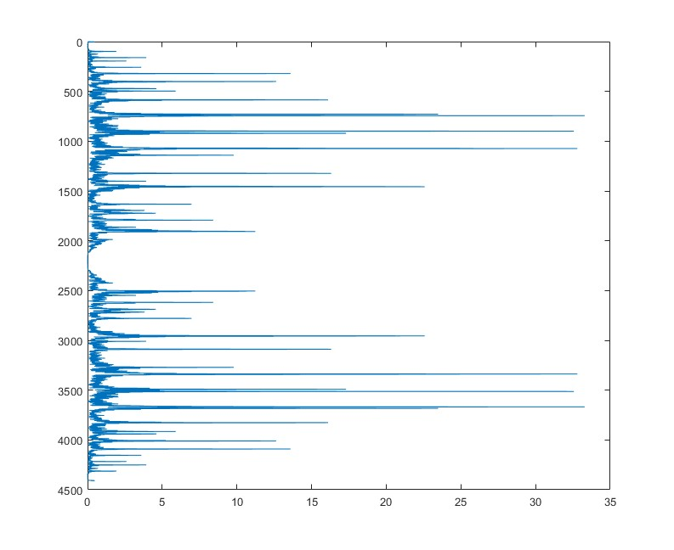
FFT – The Festive Fourier Transform
- If we’re trying to understand/manipulate any frequency component of a signal, the FT is central, including amplitude modulation/frequency band modulation etc.
- A spectrogram is a series of time-binned Fourier transforms.

Slide 32
Filtering Festively
So, we know the following:
- Filters remove things. - That the Fourier Transform is central to understanding/manipulating frequency. - That functions are mathematical relationship of X to Y.
What does this mean for our intuition on filters and how they work?

Slide 33
Filtering Festively
So, we know the following:
- Filters remove things. - That the Fourier Transform is central to understanding/manipulating frequency. - That functions are mathematical relationship of X to Y.
What does this mean for our intuition on filters and how they work?
It means you all already implicitly understand the core concepts of filters, even if you haven’t put that together yet!

Slide 34
Filtering Festively
So, we know the following:
- Filters remove things. - That the Fourier Transform is central to understanding/manipulating frequency. - That functions are mathematical relationship of X to Y.
What does this mean for our intuition on filters and how they work?
It means you all already implicitly understand the core concepts of filters, even if you haven’t put that together yet!
Signal – Amplitude * Time.
Fourier – Transform to Frequency * Power.
‘Filter’ – Manipulate the Power half of that function
Inverse Fourier – It’s a mathematical transform, which means we can do the reverse transform.
Filtered Signal! - Back to Amplitude * Time

Slide 35
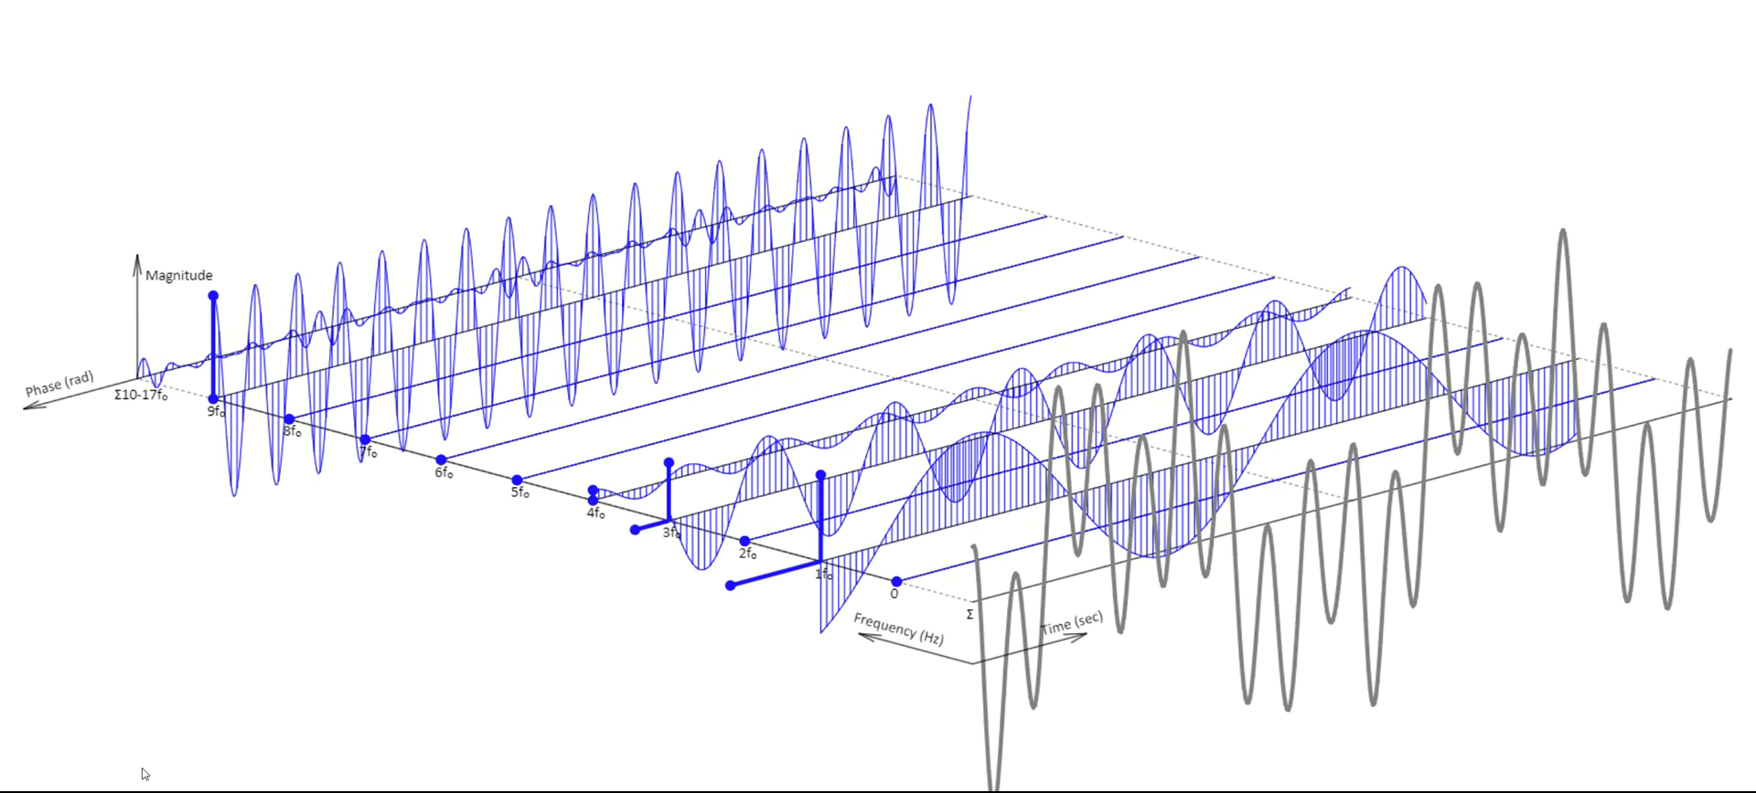
Filtering Festively
https://www.tomasboril.cz/fourierseries3d/en/

Slide 36
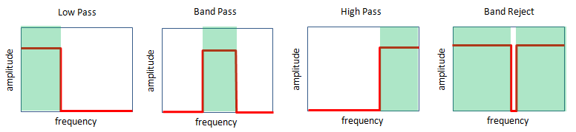
Filtering Festively
The complex part of filtering is setting things like window size, frequency bands, roll-offs, overlaps etc.
As a raw concept you have all the knowledge!! For now, just a brief view on filter types:

Slide 37
Christmas Convolution
A convolution is an operation on two functions that produces a third function – Function A * Function B Easy right!!!

Slide 38
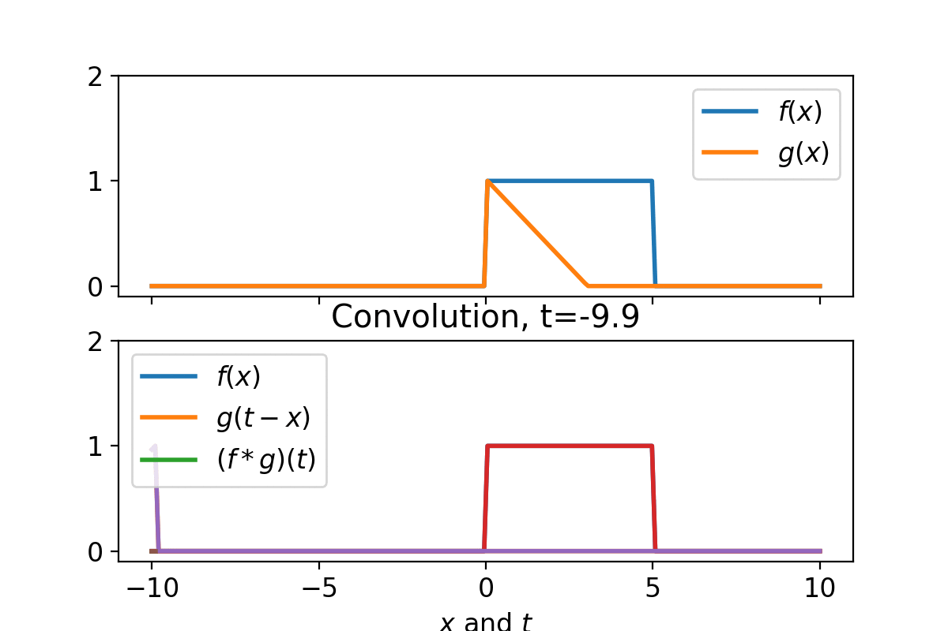
Christmas Convolution
A convolution is an operation on two functions that produces a third function – Function A * Function B Easy right!!!

Slide 39
Christmas Convolution
A small step back, let’s think about echos and reverberance
.

Slide 40
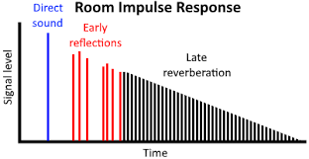
Christmas Convolution
A small step back, let’s think about echos and reverberance.
A resonant or echo room has a specific amplitude response to a given signal. We can parameterize that response mathematically… we can describe the response with a function…

Slide 41
Christmas Convolution
A small step back, let’s think about echos and reverberance.
A resonant or echo room has a specific amplitude response to a given signal. We can parameterize that response mathematically… we can describe the response with a function…
Now, imagine we want to simulate a sound inside that reverberant space…

Slide 42
Christmas Convolution
Hence why the abstraction of a convolved signal is it moving ‘backwards’ over a signal – The first part of the response ‘convolves’ with the first part of the signal. Consider f(x) to be a continuous tone, and g(x) to be the function of reverberation.

Slide 43
Christmas Convolution
Why do we care?
It’s true that convolution is largely used for manipulating signals in ways that we don’t often do….

Slide 44
Christmas Convolution
Why do we care?
It’s true that convolution is largely used for manipulating signals in ways that we don’t often do….
EXCEPT FOR THE FOUNDATION OF FMRI ANALYSIS!!!!!

Slide 45
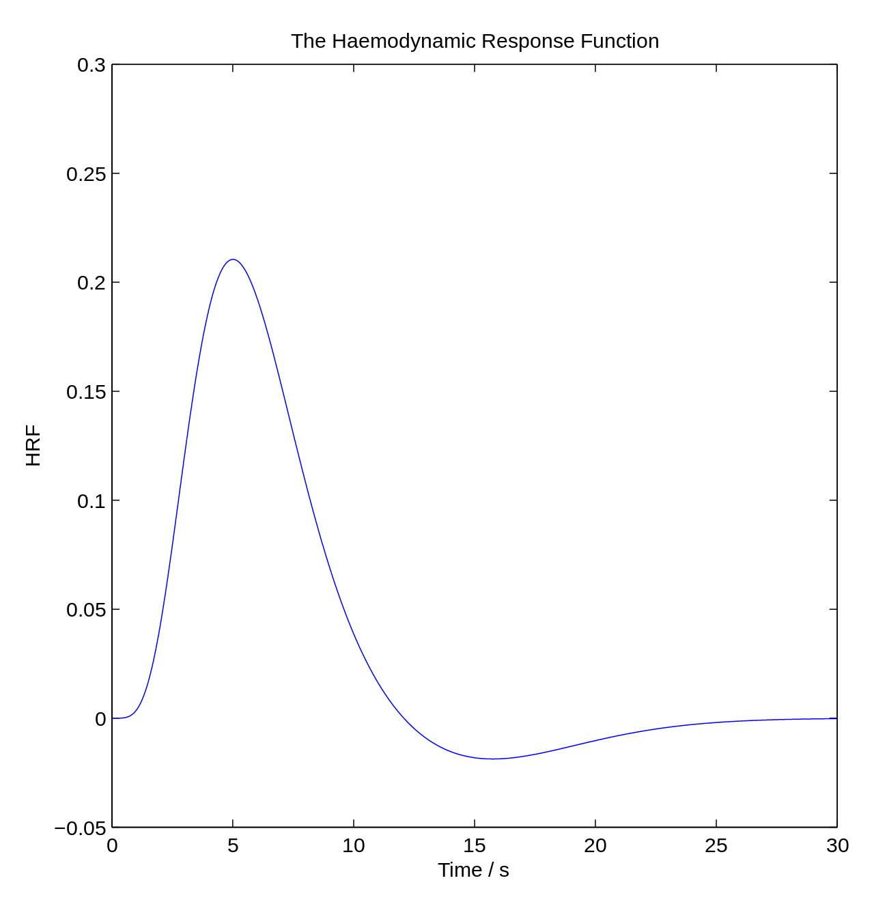
Christmas Convolution – fMRI (F for Festive)
The canonical Hemodynamic Response Function – A function that describes the blood flow to neurons after activation with set parameters.
FMRI is measuring blood flow, and it’s slow. We want to measure processes faster than this…. So how do we do that?

Slide 46
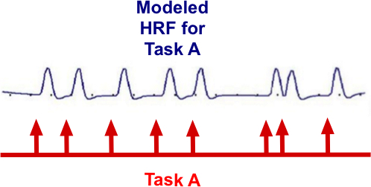
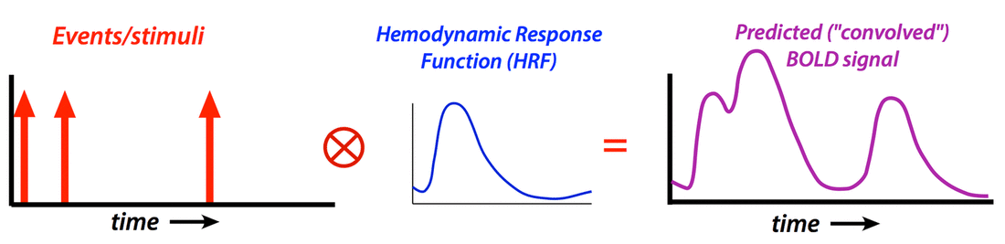
Christmas Convolution – fMRI (F for Festive)
The canonical Hemodynamic Response Function – A function that describes the blood flow to neurons after activation with set parameters.
FMRI is measuring blood flow, and it’s slow. We want to measure processes faster than this…. So how do we do that? We convolve the HRF, with a function describing our experimental events to create a ‘predicted’ BOLD signal. We regress that predicted signal (and others) against the raw data, beta-weights telling us the contribution of a given predicted signal.

Slide 47
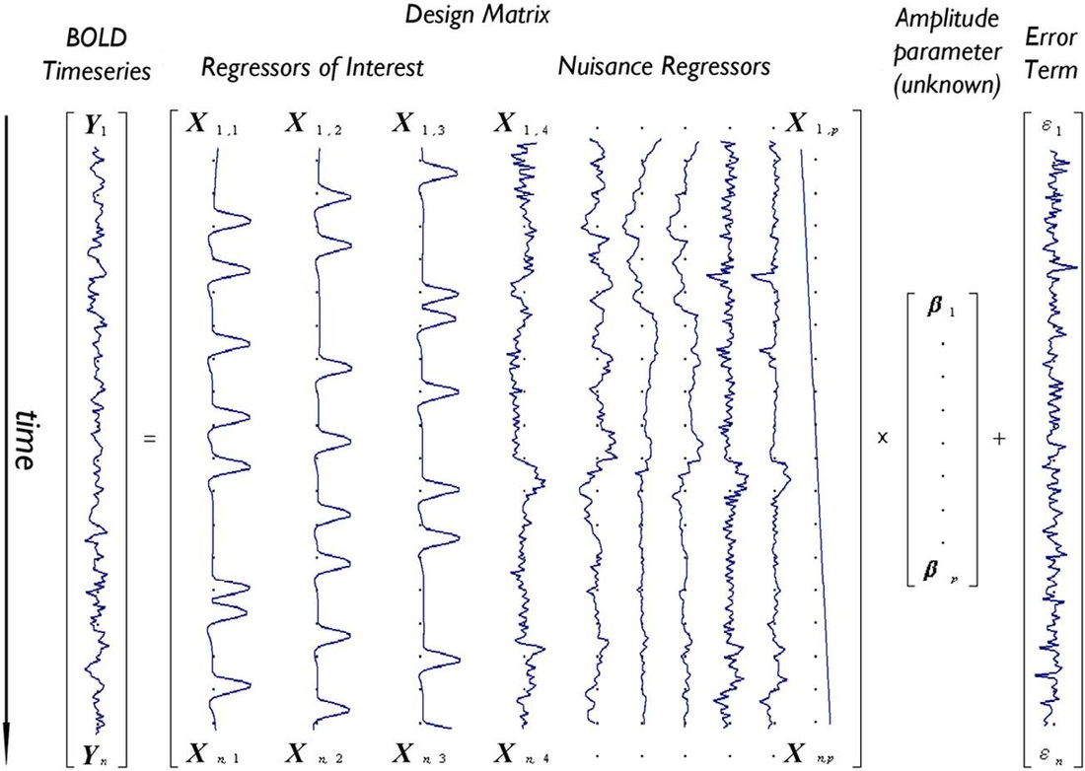
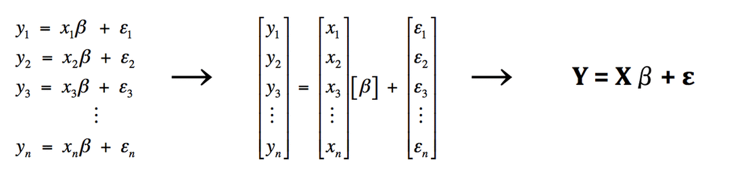
Christmas Convolution – fMRI (F for Festive)
The design matrix is a heap of different convolved signals being assessed for their ‘predictive’ power (beta weight) of the actual data + error. BOLD Signal = (Regressors * Betas) + Error

Slide 48
Christmas Convolution – fMRI (F for Festive)
The design matrix is a heap of different convolved signals being assessed for their ‘predictive’ power (beta weight) of the actual data + error. BOLD Signal = (Regressors * Betas) + Error Huw, did you just trick us into learning the GLM?

Slide 49
Christmas Convolution – fMRI (F for Festive)
The design matrix is a heap of different convolved signals being assessed for their ‘predictive’ power (beta weight) of the actual data + error. BOLD Signal = (Regressors * Betas) + Error Huw, did you just trick us into learning the GLM?
Ahh you got me!!!
But now you know that too!!! It’s all signals!!

Slide 50
Wrapping Paper Wrap Up….
Before Enrico covers convolution and TRFs…
Take away the importance of how to think from a signal processing point of view…
I’m a bad mathematician. I came at this whole field from a conceptual point of view, if I can internalize this information, all of you can!!!!
If you can grapple with SigProc in an applied manner, you can grapple with essentially all Cog-Neuro methods.
In my opinion, there is no better conceptual or analytical ‘toolbox’ for doing what we do.

Slide 51
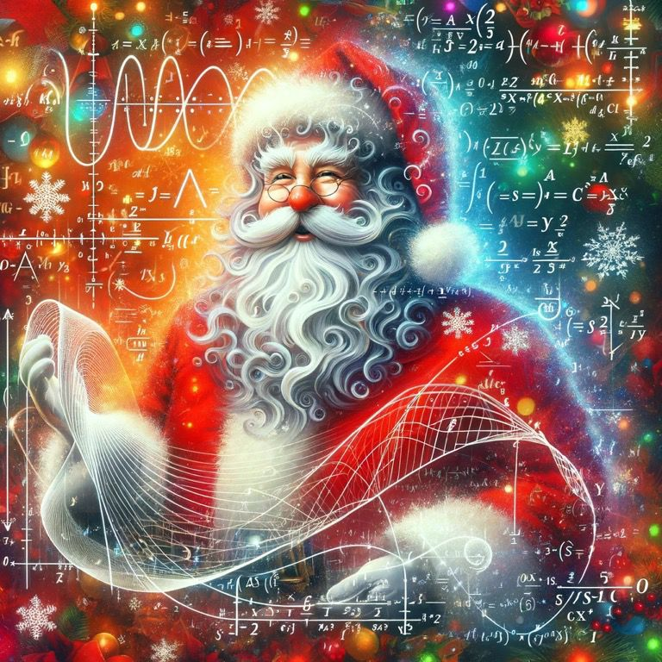
“Have A Great Winter Break! Process All The Signals!” - Signal Santa

